Slide 1
Employee Attrition Problem
Proof of Concept

Slide 2
The problem
Employee Attrition
Attrition is said to be gradual reduction in number of employees through resignation, death and retirement. The dataset provided has two types of data provided namely: “Existing employees” and “Employees who have left”. Our research here is to figure out what type of employees are leaving?; and to determine which employees are prone to leave next. I proceeded to get insight into the dataset by doing Exploratory Analysis; use Cluster Analysis to group my insight, and build a Prediction Model so as to forecast my outcome.

Slide 3
Analysis deep-dive
Exploratory Analysis
Cluster Analysis
Predictions
Exploratory Data Analysis
Exploratory Data Analysis is an underlying procedure of investigation, where you can condense attributes of information, for example, design, patterns, exceptions, and speculation testing utilizing elucidating measurements and perception.
Cluster Analysis
Cluster Analysis is the task of grouping a set of objects in such a way that objects in the same group (called a cluster) are more similar (in some sense) to each other than to those in other groups (clusters) --Wikipedia
Building Prediction Model
Prediction Model is a process that uses data mining and probability to forecast outcomes.

Slide 4
Exploratory Analysis

Slide 5
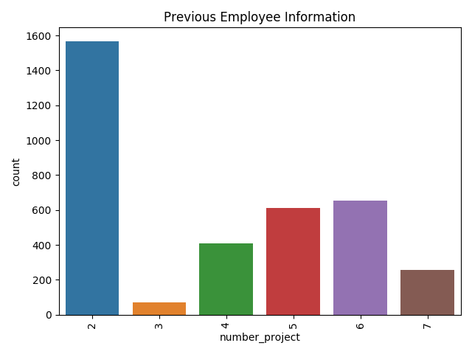
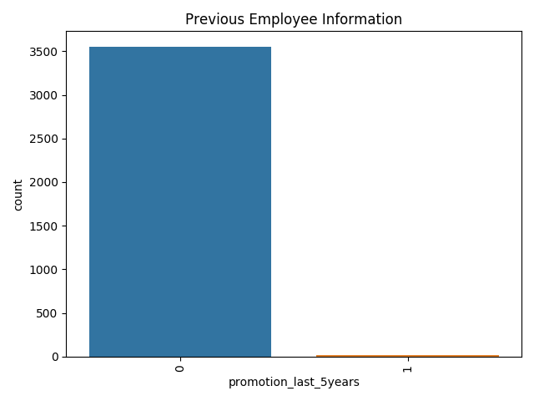
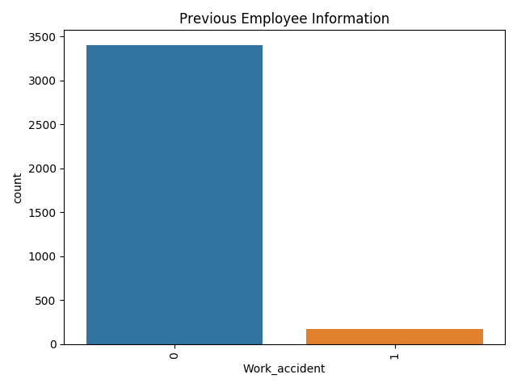
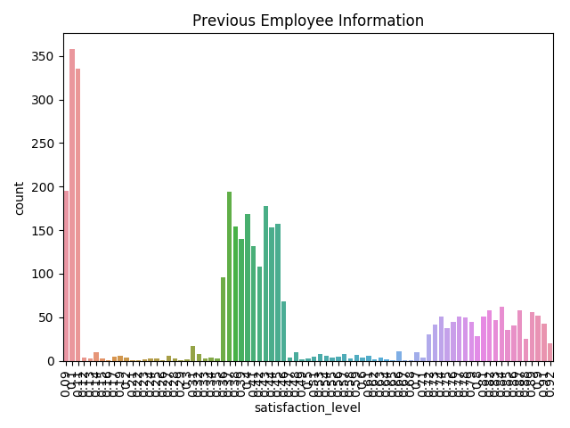
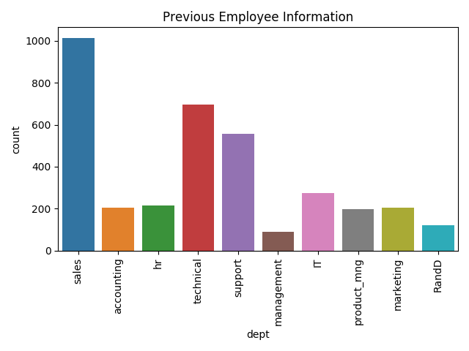
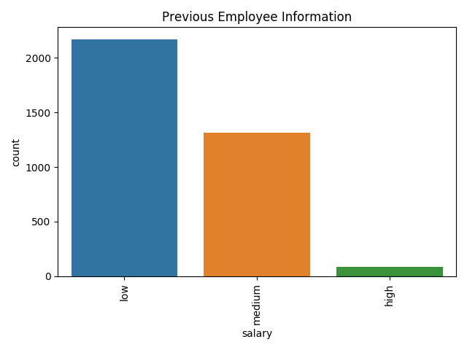
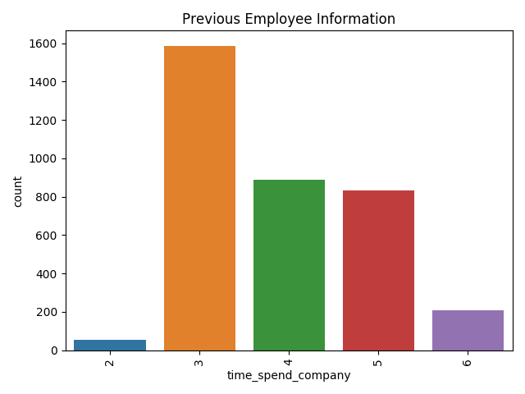
Previous Employee Exploratory Analysis Graph
So I ran exploratory analysis on the dataset to come up with the following graph plot.

Slide 6
Previous Employee Observations
It is observed that a larger percentage of employees do only 2 projects, but most of the employee are doing about 4 to 6 projects.
It is observed that only few employee take high salary. Majority are getting salary either medium or low.
Generating a descriptive statistics on the current and previous employee dataset, it shows that current employee amounts to 11,428, while total number of employee that left the company counts up to 3,571 employees. This means 23.8% of the total employee left the company.
A larger percentage of employee didn’t get promotion in the last 5 years.
I also observed that the Sales Department, Technical Department, and Support Department has the maximum number of employees respectively.
It is observed that most employee spend between 3 to 5 years in the company and very few stayed up to 6 years. So there is a fall in number of years people stayed and work with the company.
It is observed from the dataset of employees who left the company and who took larger projects are less satisfied while those ones that left the company but took lesser project are highly satisfied.
It is also observed that satisfaction level reduced based on the number of years spent at the company.

Slide 7
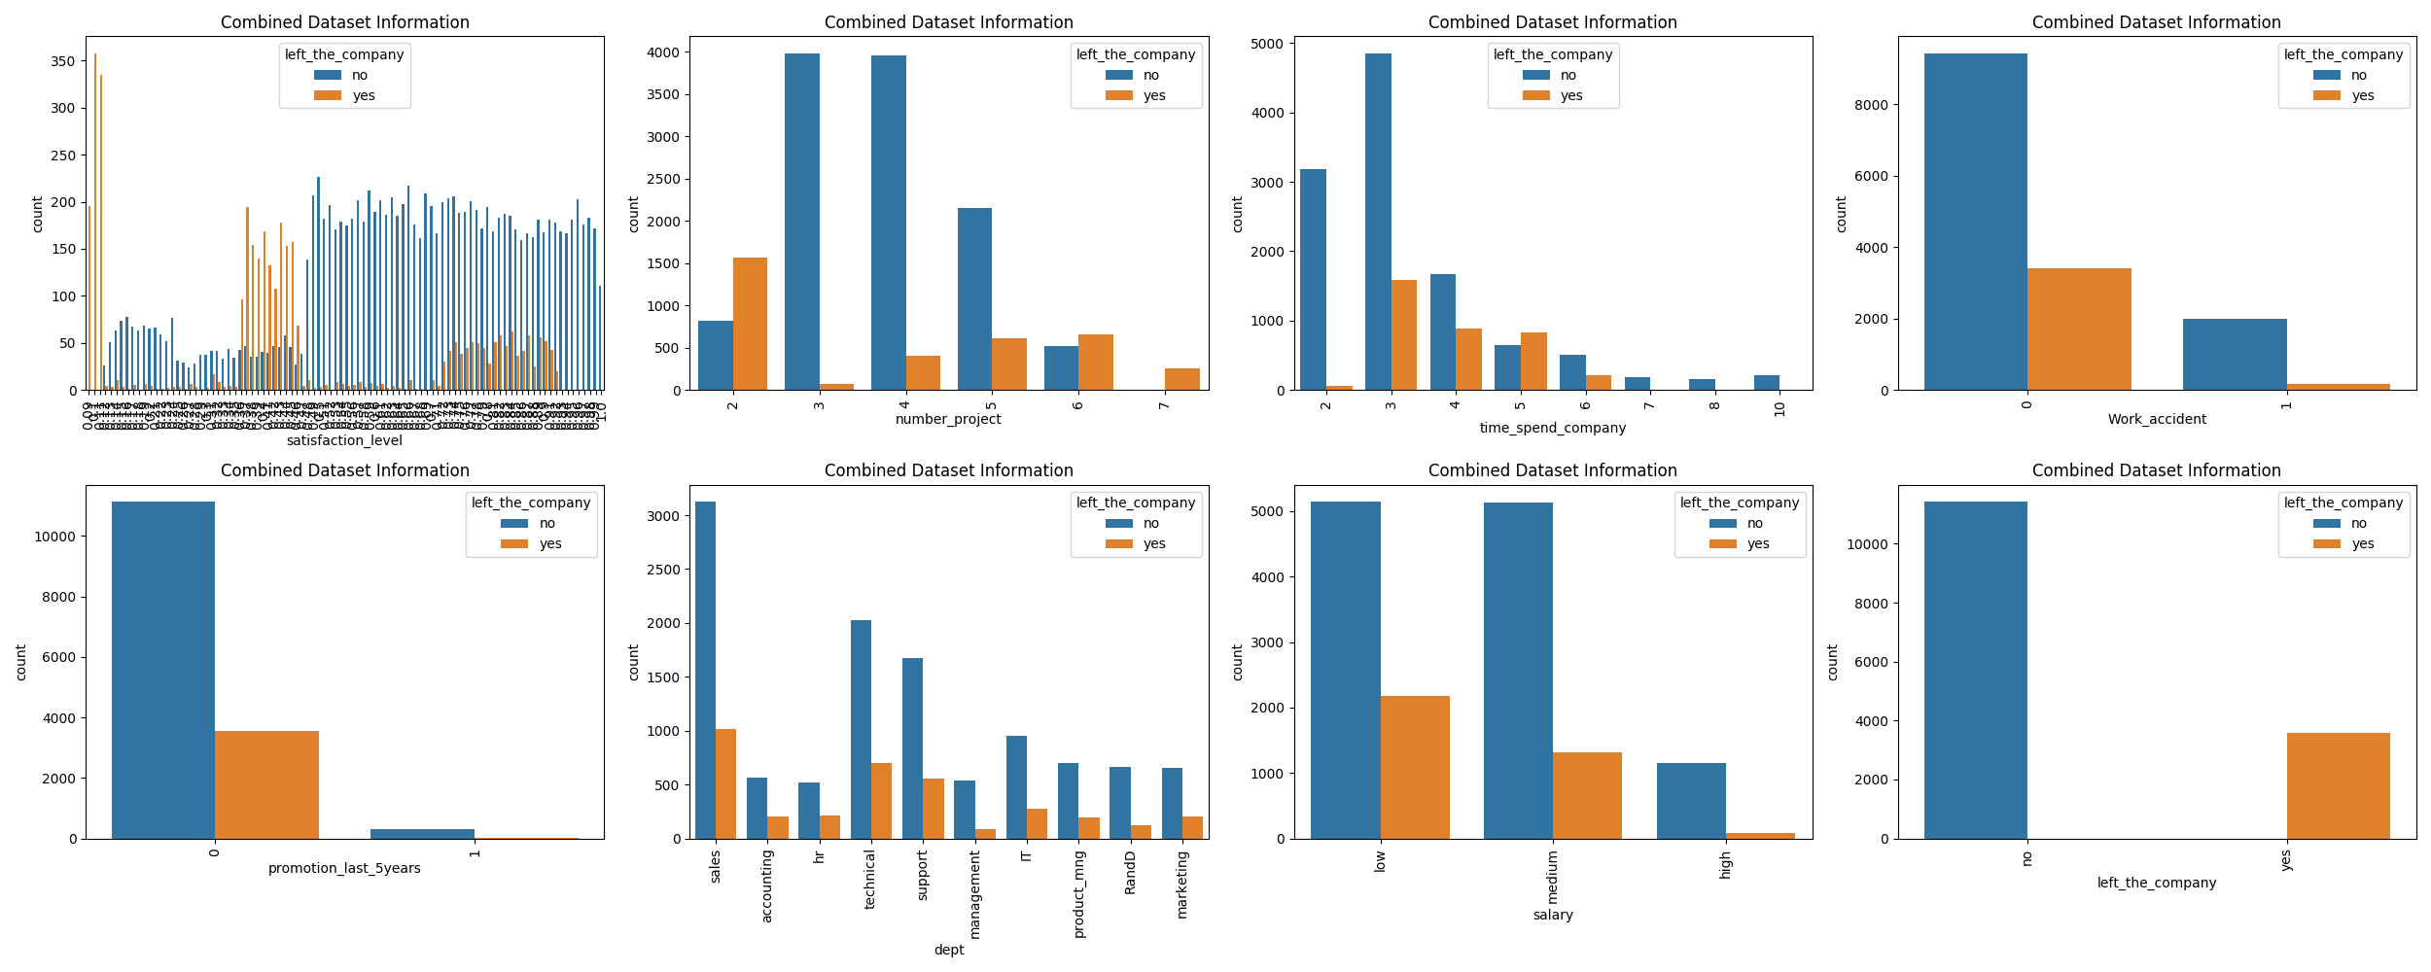
Concatenated Comparison Analysis Graph for both Datasets
(Previous & Current Employee)

Slide 8
Exploratory Analysis points based on combined dataset
Based on number of projects, we can now from the comparison see that those employees who have the number of projects more than 6 left the company.
Based on number of projects, the employees who had done 6 and 7 projects left the company. It seems they were overloaded with work.
Based on promotion, it is also clear that there wasn’t promotion in 5 year and it highly contributed to the number of employees leaving. I believe the company doesn’t have a foresight to grow employees as it seems and they are being bombarded with work.
Based on promotion, employees who got promotion in last 5 years didn't leave, meaning that all those that left the company didn't get the promotion in 5 years.
The employee with 6 years stay/experience are not leaving probably because of the time they have invested into the company.
Low and Medium salary earners in the company are majorly the employee leaving.

Slide 9
Exploratory Analysis Conclusion
The following are the major reasons employees are leaving:
Promotion
Emolument/Salary
Number of Project
Time Spent in Company
Considering the information on the graph regarding the aforementioned reasons, I believe the company will turn things around if they look at threshold of 3 Projects and 5 Projects, as well as the information we deduced being the fact that most employee left at Year 5. A three-year threshold is mostly important for the employee from what the datasets say and if they aren't seeing value for it, they mentally quit and start searching for jobs at Year 3 because the analysis shows high loyalty of employee at year 3. A larger percentage earning less than expected quit, and promotion information backs that up so well that employees leave once there is not promotion and it turns shows on their salary, so they quit.

Slide 10
Cluster Analysis

Slide 11
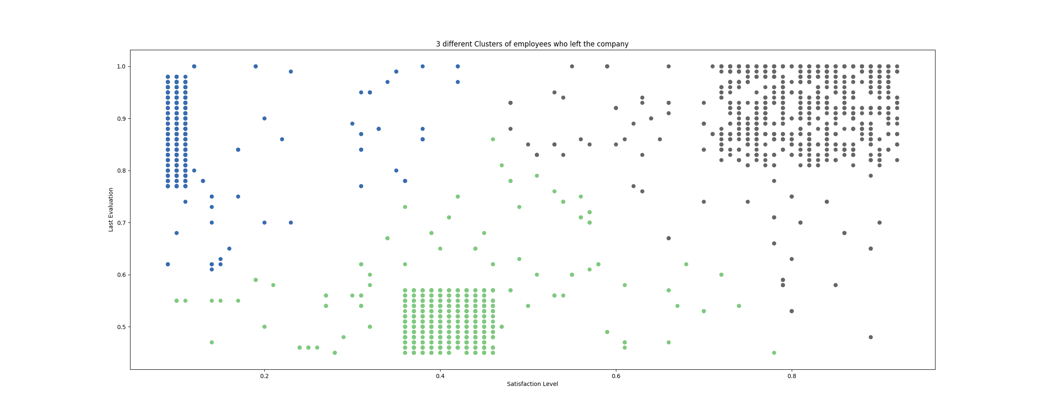
Cluster Analysis
It seems the most important factor for employees is Satisfaction and Performance in the company. This insight is to group employees who left by those factors to ascertain our facts.

Slide 12
Cluster Analysis Conclusion
Naturally when you have a very Low Satisfaction Level with High Evaluation which are shaded Blue the graph can be tagged as Frustrated Employee and as a result they left the company.
The Green clusters of the graph shows Average Satisfaction Level and Low Evaluation shows they ain’t getting what they need and they might actually be seen as a bad match and hence why they left.
Grey shading of the graph has High Satisfaction Level and High Evaluation and is the major criteria that determines why employees left.

Slide 13
Prediction
Result/Output: Accuracy: 0.9771111111111112
Precision: 0.976482617586912
Recall: 0.9227053140096618
97% Accuracy, 97% Precision, 92% Attrition Identification.

